Slide 2
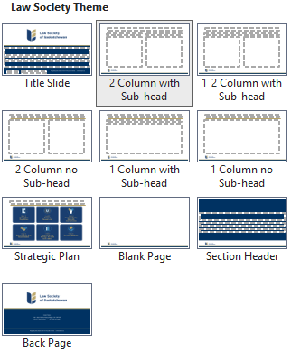
(For Reference Only) – PowerPoint Template
Available slide layouts
Title slide
Section header slide (e.g., for section titles or breaks)
One column slide with and without sub-headings
Two column slides with and without sub-headings and with one subheading only
Blank slide
Strategic plan slide
Back page (e.g., ending) slide

